Slide 1

AAROGYA SRI
BITSOM
Product Management with GenAI and AgenticAI
Team:
Anusriraje | Vigneshwar | Mayurika | Ananya | Vaibhav

Slide 2
PROBLEM STATEMENT
The Core Problem
Millions lack access to trusted health information
Language barriers block understanding
Dependence on misinformation (WhatsApp, hearsay)
High cost and delays in healthcare decisions
Why this matters
Delayed care increases health risks
Preventive care is underutilized
Anxiety and uncertainty remain high

Slide 3
TARGET USERS & CONTEXT
Primary Users
Low–middle income families
Tier 1, 2 & 3 Indian cities
Entry-level Android users
Regional language speakers
User Reality
Limited digital literacy
Low trust in online health content
Cost-sensitive decisions

Slide 4
SOLUTION OVERVIEW
Our Solution: Aarogya Sri
AI-powered health guidance
Voice + text interaction
Delivered in local Indian languages
Works on low internet connectivity
What we DO
Education, awareness, prevention
What we DON’T
Diagnosis, prescriptions, emergencies

Slide 5
WHY THIS IS BETTER
Compared to Alternatives:
Google → Generic & English-heavy
YouTube → Unverified & risky
Hospitals → Costly & time-consuming
Aarogya Sri Advantage:
Language-first design
Verified, safety-bounded AI
Conversational & accessible

Slide 6
VALUE PROPOSITION
One-Line Value Proposition:
“Aarogya Sri provides trusted health guidance in local languages using AI, anytime and anywhere.”
User Value Delivered
Clarity instead of confusion
Trust instead of misinformation
Guidance instead of anxiety

Slide 7
MVP USER FLOW
User Journey
1.Select preferred language
2.Ask health query (voice/text)
3.AI asks clarifying questions
4.Verified guidance is provided
5.Next steps suggested

Slide 8
INFORMATION ARCHITECTURE
The Information Architecture of the health chatbot organizes all features clearly so users can navigate easily. The user journey starts by selecting a preferred language. Then the user asks a health query using voice or text. The AI assistant asks clarifying questions to better understand the problem. After that, verified health guidance is provided. Finally, the app suggests the next steps for the user.

Slide 9
AI CAPABILITIES & SAFETY
AarogyaSri AI
•Multilingual Trusted Health Information Assistant
•Role of AI:
•• Enable trusted health access for underserved users
•• Remove language & accessibility barriers
•• Act as a 24x7 digital health companion
•• Support preventive care and early risk

Slide 10
Key AI Use Cases
•• Multilingual Health Q&A (voice & text)
•• Personalized daily health tips
•• Wearable data insights (MVP+)
•• Smart triage and nurse escalation

Slide 11
GenAI & Agentic Behaviour
•• Simplifies complex medical information
•• Asks clarifying questions when needed
•• Sends proactive daily health tips
•• Maintains user context across sessions
•• Monitors patterns and flags risks

Slide 12
AI Responsibilities, Triggers & Boundaries
•Responsibilities:
•• Understand multilingual queries
•• Provide verified, non-diagnostic guidance
•• Detect red-flag symptoms
•• Personalize responses
•Boundaries:
•• No diagnosis or prescriptions
•• No emergency treatment

Slide 13
Safety, Failure Handling & AI Metrics
•Failure Handling:
•• Low confidence → nurse escalation
•• High-risk → emergency guidance
•• Ambiguous input → clarification
•AI Metrics:
•• Accuracy ≥ 85%
•• Hallucination < 5%
•• Red-flag detection ≥ 90%

Slide 14
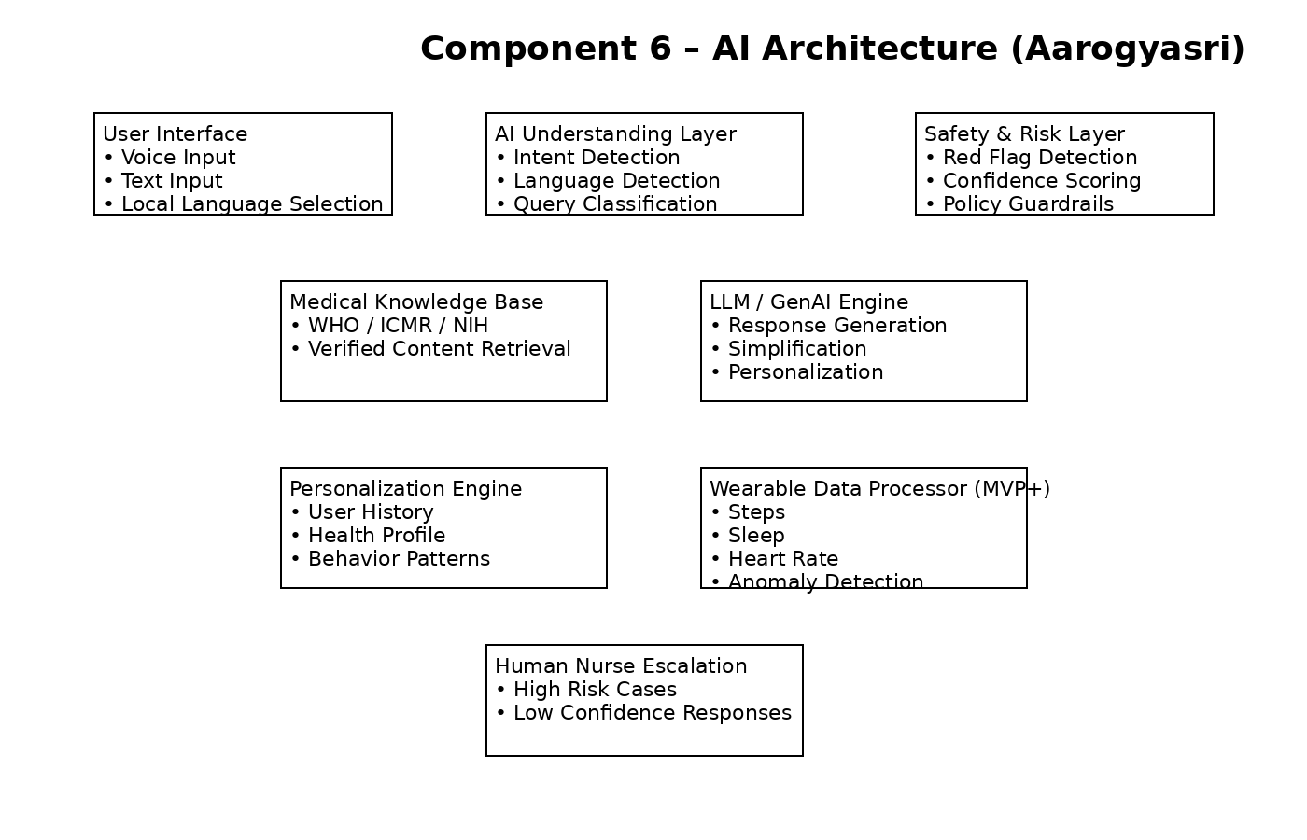

Slide 15
METRICS & SUCCESS
User Metrics:
DAU / MAU
Retention
CSAT / NPS
AI Metrics:
≥ 85% accuracy
< 5% hallucination
≥ 90% red-flag detection
Business Metrics:
Free → Premium conversion
Cost per user
Nurse support margin

Slide 16
Revenue Model Selection
Fremium Model
Freemium AI health Q&A (mass adoption)
Premium subscription (advanced explanations, tracking)
Paid nurse support (on-demand human assistance)
Limited, ethical health-related ads
Why this works
Low entry barrier
Multiple revenue streams
Balances scale with sustainability

Slide 17
Resource Availability Check
Key Resources Required
AI models (language + health content)
Engineering team
Verified health content
Nurse partner network
Assessment-
All resources are readily available
No dependency on rare technology or licenses

Slide 18
Team Structure & Responsibilities
Vigneshwar – Frontend & Backend Development
Anusriraje – Requirement Analysis & PRD
Mayurika – Testing & Quality Assurance
Ananya – User & Market Research
Vaibhav – UI/UX Design

Slide 19
Aarogya Sri
Trusted healthcare guidance — for every
language, every home.
Thank You

